Slide 1
HEART DISEASE PREDICTION algorithm
Enrique Guillermo Paz
Coderhouse

Slide 2
AGENDA
Objective​
Dataset
Exploratory Data Analysis
Models
​Imbalance Correction
Hyperparameter Optimization
Model Stacking

Slide 3
objective
Develop a model capable of predicting the onset of heart disease based on risk factors and previous history of the patient.

Slide 4
dataset

Slide 5

dataset
The Behavioral Risk Factor Surveillance System (BRFSS) objective is to collect a on preventive health practices and risk behaviors that are linked to chronic diseases.
Data are collected from a random sample of adults. Through a telephone survey completes more than 400,000 adult interviews each year.

Slide 6
Exploratory data analysis (EDA)

Slide 7
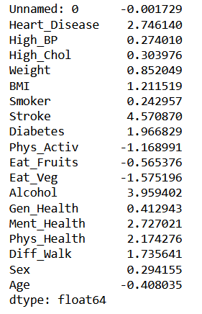
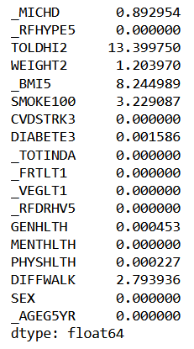
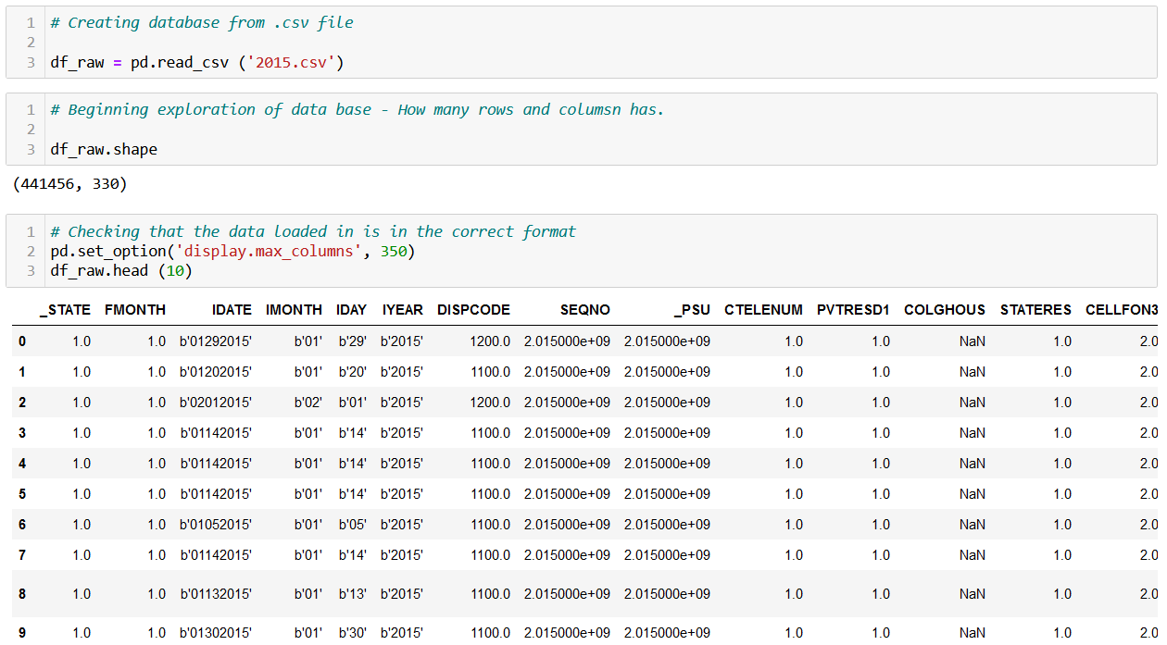
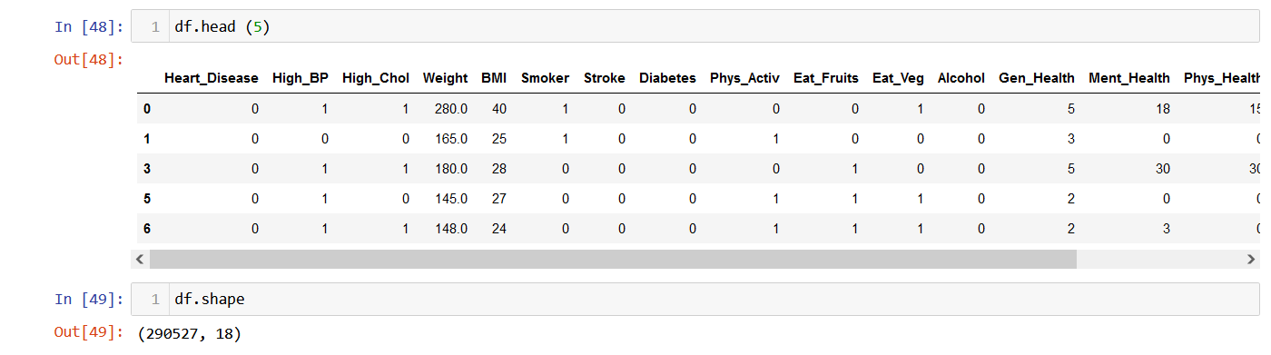
eda
Dataset Analysis

Slide 8
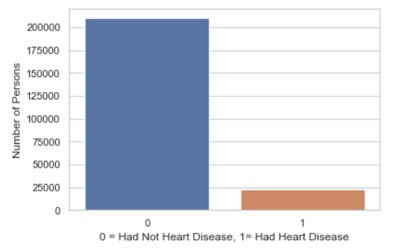

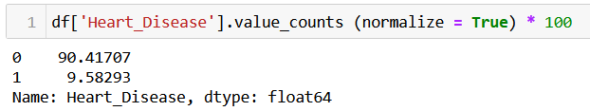
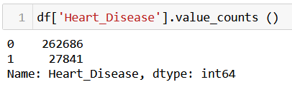
eda
Target Variable
Heart_Disease: Binary/Boolean
UNBALANCED

Slide 9
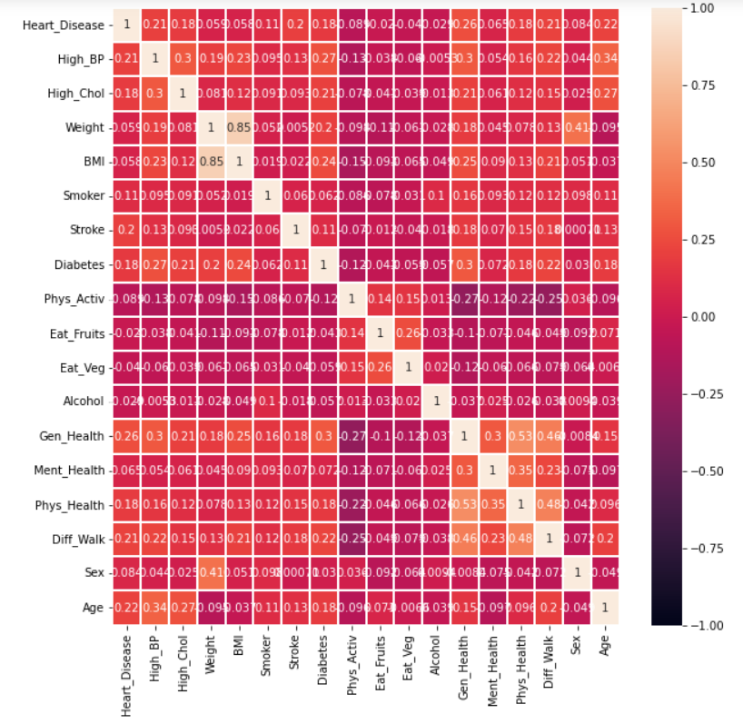
eda
Analisis multivariable

Slide 10
models

Slide 11
models
Classification:
Logistic Regrssion
K Nearest Neighbor
Random Forest
Extreme Gradient Boost
Classificattion Tree
Metric: Sensitivity/Recall score.

Slide 12
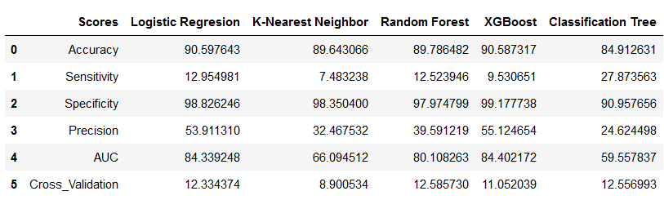
models

Slide 13
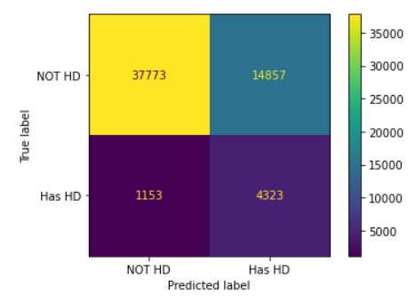
models

Slide 14
Imbalance correction

Slide 15

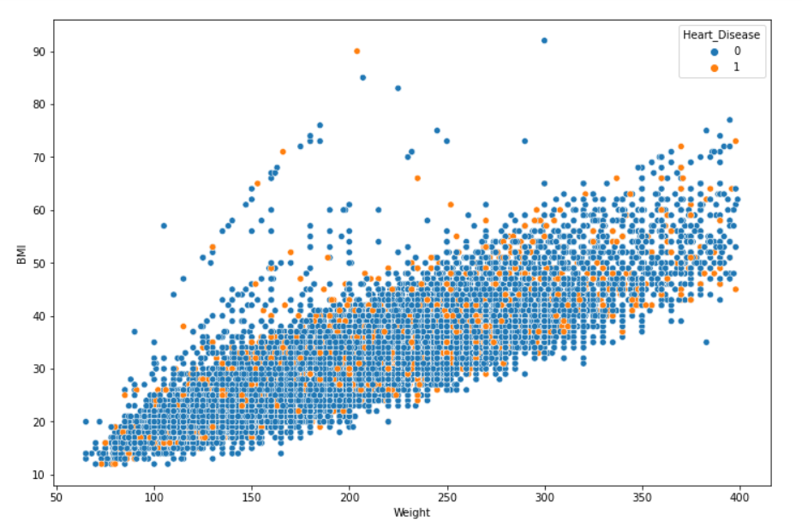
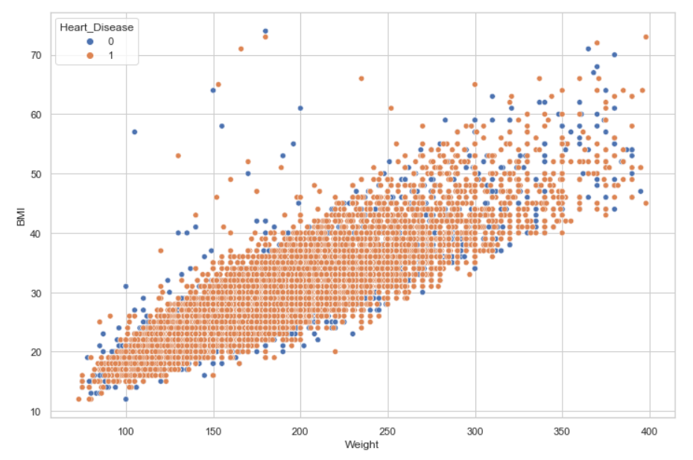
Imbalance correction

Slide 16
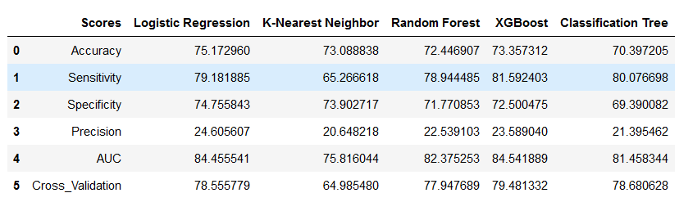
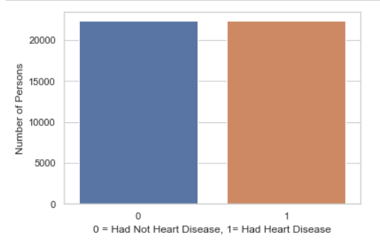

Imbalance correction

Slide 17
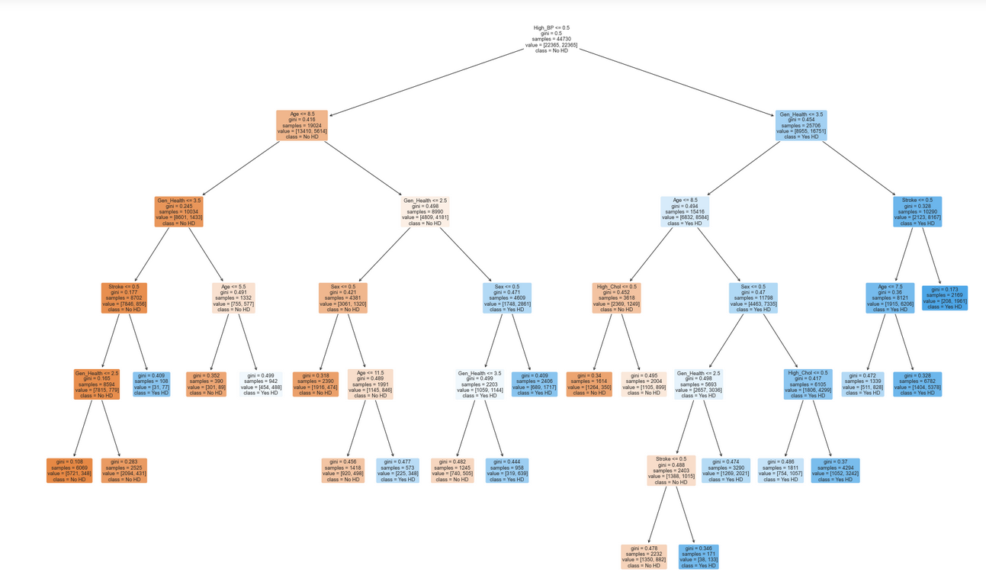
Model selected

Slide 18



COMING SOON
GRIDSERCH
OPTUNA
MODEL STACKING

Slide 19
THANK YOU
Enrique Guillermo Paz
pazenriqueguillermo@gmail.com

